Slide 1
Eclipse Plug-in Development
Introduction of Development Tools
JDT and PDE

Slide 2
Contents
JDT - Java Development Tooling
Java Model
Type Hierarchy
Search Engine
PDE - Plug-in Development Environment
UI
API Tools
Build

Slide 3
JDT
Java Model – Lightweight model for views
OK to keep references to it
Contains unresolved information
From projects to declarations (types, methods, …)

Slide 4
JDT
Java Model – Lightweight model for views
Java model and its elements
Classpath elements
Java project settings
Creating a Java element
Change notification
Type hierarchy
Code resolve

Slide 5
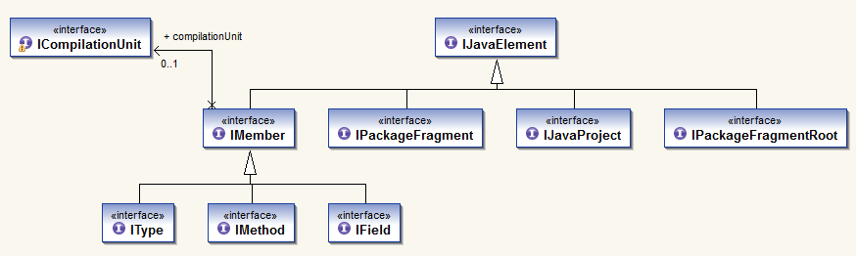
Java Model
Java Elements API

Slide 6
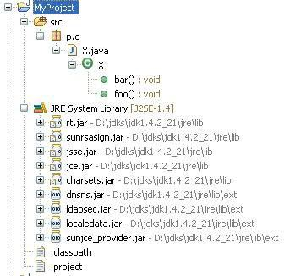
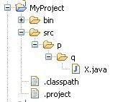
Java Model
Java Elements API
IJavaProject
IPackageFragmentRoot
JavaCore.create(resource)
IPackageFragment
IType
ICompilationUnit / IClassFile
IMethod IField IInitialzier
element.getParent()
IProject
IFolder
IFile
element.getChildren()
javaElement.getResource()

Slide 7
Java Model
Using the Java Model
Setting up Java project
Java nature
Java builder
Java class path
IWorkspaceRoot root = ResourcesPlugin.getWorkspace().getRoot();
IProject project = root.getProject(projectName);
project.create(null);
project.open(null);
IProjectDescription description = project.getDescription();
description.setNatureIds(new String[] { JavaCore.NATURE_ID });
project.setDescription(description, null);
IJavaProject javaProject = JavaCore.create(project);
IClasspathEntry[] classPath = new IClasspathEntry[0];
// define class path here
IPath defaultOutputLocation = null;
javaProject.setRawClasspath(classPath, defaultOutputLocation, null);

Slide 8
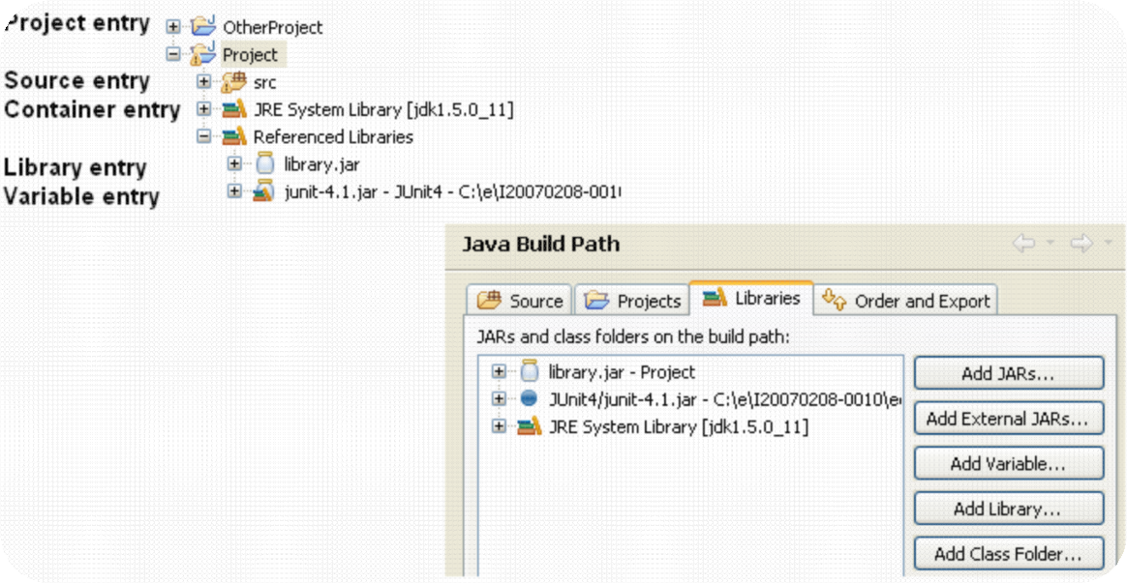
Java Model
Java class path
The Java element hierarchy is defined by the Java classpath
Classpath entries define the roots of package fragments

Slide 9
Java Model
Classpath
Source entry: Java source files to be built by the compiler
Folder inside the project or the project itself
Possibility to define inclusion and exclusion filters
Compiled files go to either a specific or the projects default output location
Library entry: Class folder or archive
Class files in folder or JAR archive, in workspace or external
Source Attachment specifies location of library’s source
IPath srcPath = javaProject.getPath().append("src");
IPath[] excluded = new IPath[] { new Path("doc") };
IClasspathEntry srcEntry = JavaCore.newSourceEntry(srcPath,
excluded);
IClasspathEntry libEntry = JavaCore.newLibraryEntry( new Path("d:/lib/foo.jar"), // library location
new Path("d:/lib/foo_src.zip"), // source archive location new Path("src"), // source archive root
true); // exported

Slide 10
Java Model
Creating Java Elements
Java project
IJavaProject javaProject = JavaCore.create(project);
IClasspathEntry[] buildPath = {
JavaCore.newSourceEntry(project.getFullPath().append("src")),
JavaRuntime.getDefaultJREContainerEntry() };
javaProject.setRawClasspath(buildPath, project.getFullPath().append("bin"), null);
Source folder
IFolder folder = project.getFolder("src");// Create the source folder
folder.create(true, true, null);
IPackageFragmentRoot srcFolder = javaProject.getPackageFragmentRoot(folder);
Assert.assertTrue(srcFolder.exists()); // resource exists and is on build path
Package
IPackageFragment fragment= srcFolder.createPackageFragment("x.y", true, null);
Create compilation unit
String str = "package x.y;" + "\n"
+ "public class E {" + "\n"
+ " String first;" + "\n"
+ "}";
ICompilationUnit cu = fragment.createCompilationUnit("E.java", str, false, null);
Create a field
IType type= cu.getType("E");
type.createField("String name;", null, true, null);

Slide 11
Java Model
JavaCore.addElementChangedListener(new IElementChangedListener() {
public void elementChanged(ElementChangedEvent event) {
boolean res = hasTypeAddedOrRemoved(event.getDelta());
}
private boolean hasTypeAddedOrRemoved(IJavaElementDelta delta)
IJavaElement elem = delta.getElement();
boolean isAddedOrRemoved = (delta.getKind() != IJavaElementDelta.CHANGED);
switch (elem.getElementType()) {
case IJavaElement.JAVA_MODEL:
case IJavaElement.JAVA_PROJECT:
case IJavaElement.PACKAGE_FRAGMENT_ROOT:
case IJavaElement.PACKAGE_FRAGMENT:
if (isAddedOrRemoved)
return true;
return processChildrenDelta(delta.getAffectedChildren());
case IJavaElement.COMPILATION_UNIT:
ICompilationUnit cu = (ICompilationUnit) elem;
if (!cu.getPrimary().equals(cu))
return false;
if (isAddedOrRemoved|| isPossibleStructuralChange(delta.getFlags()))
return true;
return processChildrenDelta(delta.getAffectedChildren());
case IJavaElement.TYPE:
if (isAddedOrRemoved)
return true;
return processChildrenDelta(delta.getAffectedChildren()); // inner types
default: // fields, methods, imports...
return false;
}
}
});
Change notification

Slide 12
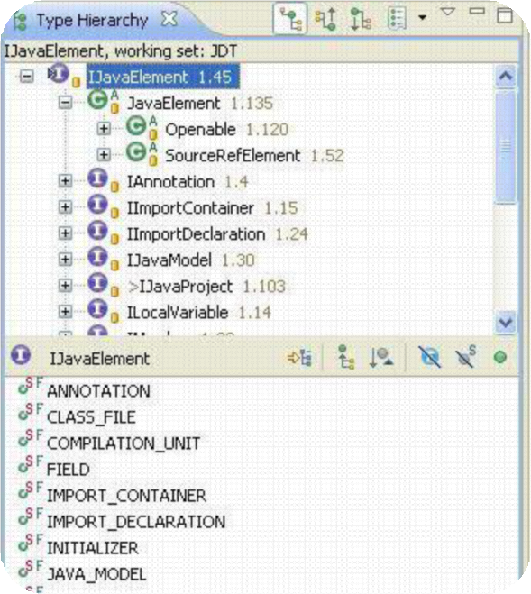
Java Model
Type Hierarchy
Snapshot of ITypes in a sub/super type relationship
Used in Type Hierarchy view

Slide 13
Java Model
Type Hierarchy
Create – on a type or on a region (= set of Java Elements)
typeHierarchy= type.newTypeHierarchy(progressMonitor);
typeHierarchy= project.newTypeHierarchy(region, progressMonitor);
Supertype hierarchy – faster!
typeHierarchy= type.newSupertypeHierarchy(progressMonitor);
Get super and subtypes, interfaces and classes
typeHierarchy.getSubtypes(type)
Change listener – when changed, refresh is required
typeHierarchy.addTypeHierarchyChangedListener(..);
typeHierarchy.refresh(progressMonitor);

Slide 14
Java Model
Code resolve
Resolve the element at the given offset and length in the source
javaElements= compilationUnit.codeSelect(50, 10);
Used for Navigate > Open (F3) and tool tips

Slide 15
Java Model
More Java Model Features
Navigation – resolve a name
IType type= javaProject.findType("java.util.Vector");
Context – resolve an enclosing element
element= compilationUnit.getElementAt(position);
Code assist – evaluate completions for a given offset
compilationUnit.codeComplete(offset, resultRequestor);
Code formatting
ToolFactory.createCodeFormatter(options) .format(kind, string, offset, length, indentationLevel, lineSeparator);

Slide 16
API in JDT UI
Labels, images, structure, order for IJavaElements
JavaElementLabelProvider
StandardJavaElementContentProvider
JavaElementComparator
Selection and configuration dialogs, wizards
JavaUI.createPackageDialog(…), JavaUI.createTypeDialog(…)
BuildPathDialogAccess
NewClassWizardPage, NewInterfaceWizardPage…
JavadocExportWizardPage, NewJavaProjectWizardPageOne/Two
Java Actions to add to context menus
package org.eclipse.jdt.ui.actions

Slide 17
JDT
Search for declarations and references
packages, types, fields, methods and constructors
using wildcards (including camel-case) or from a Java element
Scoped search
region = set of Java elements
predefined workspace and hierarchy scopes
Potential matches
Code with errors, incomplete class paths
Limit the match locations
in casts, in catch clauses, only return types…

Slide 18
PDE
UI
Form-Based Manifest Editors
RCP Tools
New Project Creation Wizards
Import Wizards
Export Wizards
Launchers – Test and debug Eclipse applications and OSGi bundles
Views
Miscellaneous Tools – Wizard to externalize and clean up manifest files
Conversion Tools – Wizard to convert java project to plug-in project
Integration with JDT - Plug-in manifest files participate in Java search and refactoring.

Slide 19
PDE
Tools
Compatibility Analysis
Identify binary compatibility issues relative to a previous version of a plug-in.
API Restriction Tags
Javadoc tags are provided to explicitly define restrictions associated with types and members.
Version Number Validation
Identify invalid plug-in version numbers relative to a previous version of a plug-in.
Javadoc @since Tag Validation
Identify missing and invalid @since tags on types and members.
API Leak Analysis
Identify API types and methods that leak non-API types.
Quick Fixes
Quick fixes are provided to adjust plug-in versions and @since tags appropriately.

Slide 20
PDE
Build
Automated building of RCP applications from product configurations
Automated building of features
Automated building of plug-ins
Generating Ant scripts from PDE
Generating Ant scripts from scripts
Building p2 repositories and products
Builder Configuration Properties
Feature and Plug-in build properties

Slide 21
Any Questions?
Skype: jin.liu.soyatec
Email: jin.liu@soyatec.com

Slide 22
The end

